Slide 1
SOCIAL & EMOTIONAL LEARNING.
Self-Awareness.
Feelings Forecaster.
Notes:
TEACHER SLIDE
This PowerPoint file contains an instructional delivery tool for teachers who have purchased the HMH Into Reading program. This Social and Emotional Learning (SEL) lesson facilitates both in-class and remote delivery of the SEL Anchor Charts and the CASEL© competencies as shown in Focusing on the Whole Child in your Teacher’s Guide.
This slide and the next slide are intended to give you, the teacher, an overview of the lesson. Begin projecting or screen sharing the lesson with Slide 3.
First, view the slides when planning your lesson. Prepare any additional materials you want to use, such as journals.
The content is flexible. The slides may be editable when not part of art. Keep in mind you may hide any slides to fit student and schedule needs.
Teacher “DIRECTIONS” and a suggested script “SAY” are provided in the Notes section to help you facilitate. During instruction, project the slides to children, read the contents, and use the directions and scripting in the Notes to guide the lesson.
For a PDF version of the slides with the notes, print to a PDF in “Notes Page” view.
For presentation, because some of the slides and activities may involve manipulating text boxes as part of the instructional delivery, present the file in “Normal” view vs. “Slide Show” view.
Please note that children should have the tools to journal ideas and the option to discuss them either as a group or with a partner throughout the lesson.

Slide 2
Get Started
In this lesson, children discuss:
how to identify and label their feelings.
what makes them feel a certain way.
how our feelings impact the way we act.
Tools for Explore and Practice:
Journal It! Children write or draw about ideas, thoughts, and feelings they have in the lesson.
Chat About It! Children check in and talk about ideas, thoughts, and feelings with a partner or as a group.
Notes:
TEACHER SLIDE
The following is shown on this slide.
The Anchor Chart used with Self-Awareness: Feelings Forecaster
“In this lesson” lists the key concepts that will be covered.
“Tools for Explore and Practice” are the recurring methods children can use to internalize ideas.
Journal It! Make sure children have access to a personal journal they can revisit throughout all SEL lessons.
Chat About It! You know your students best. Use Chat About It! as appropriate to check in with children in the manner that best suits them. Methods could be partner turn-and-talks, thumbs up/thumbs down, group discussion, or individual check-ins. If remote, children can even share with an adult at home. Always be mindful of children’s needs around sharing and do not force them if they are not ready.
KEY CONCEPTS IN THIS LESSON
*feeling an emotional state or reaction like being happy, sad, angry, etc.

Slide 3
LEARNING GOALS
Today we will learn how to:
identify and label feelings.
predict what makes you feel a certain way.
Notes:
DIRECTIONS: START PROJECTING OR SCREEN SHARING HERE
Read the Learning Goals.
SAY:
Let’s look at our Learning Goals. In this lesson, we will learn how to identify and label our *feelings. We will also learn how to predict what makes us feel a certain way.
*feeling an emotional state or reaction like being happy, sad, angry, etc.

Slide 4
GUIDING QUESTION
What is
a feeling?
Notes:
DIRECTIONS:
Read the Guiding Question. Brainstorm initial ideas and answers with children. Be ready to revisit the question at the end of this lesson to review what children learned.
SAY:
The Guiding Question for today’s lesson is What is a feeling? Does anyone know anything about feelings? Have you ever felt a certain way based on what was happening around you? What did you do because of that feeling? Have your feelings ever changed before?
[Pause after each question to discuss responses. Gather background knowledge to understand where your students are in terms of their feeling knowledge.]
*feeling an emotional state or reaction like being happy, sad, angry, etc.

Slide 5
Let’s Explore!

Slide 6
Meet Cloudy
How do you feel today?
Notes:
DIRECTIONS:
Read Cloudy’s speech bubble to children. Ask children to think about what they are feeling. If you notice children are experiencing a strong emotion, take the opportunity to help them manage that emotion before starting the lesson.
SAY:
Before we begin today’s lesson, let’s check in with how we feel right now. Cloudy is going to help us identify and label our feelings. Cloudy wants to know how you are feeling today.
[Model identifying and labeling your feelings by using this sentence frame: Today I am feeling _______, because _______. Pause to listen to how children are feeling. If you notice children are responding with strong emotions, discuss how the first step in managing those emotions is to label and identify them and ask why the feeling is happening. Attend to any emotional needs of your students before continuing the lesson.]
It is important to check in with how we feel because our feelings affect how we act. For example, if you feel sad, you might cry. If you feel angry, your face and body might get tense. If you feel shy or nervous, you might not want to make new friends. Our feelings and thoughts are linked to our behavior.
Today, we are going to learn some new feeling words to expand our vocabulary. Notice how you feel right now and at the end of the lesson to see if your feelings have changed.
*feeling an emotional state or reaction like being happy, sad, angry, etc.

Slide 7
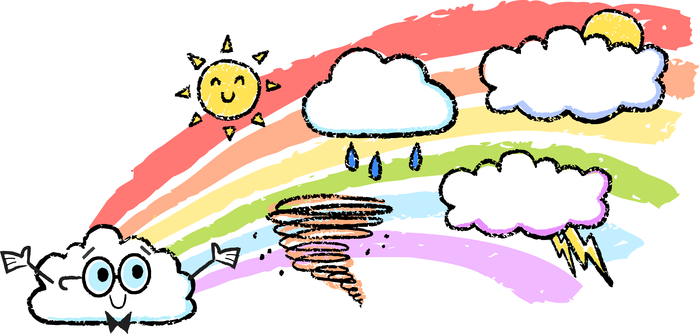
Feelings Forecaster
What makes you happy?
What makes you hopeful?
What makes you sad?
It’s okay to feel a certain way!
What makes you angry?
What makes you
frustrated?
Notes:
DIRECTIONS:
Read Cloudy’s speech bubble. Talk through each question with children and model responses using the sentence stem.
SAY:
Cloudy says “It’s okay to feel a certain way!” What do you think Cloudy means? [Discuss responses.]
Everyone has their own *feelings. Sometimes we feel a certain way based on what is happening around us. Just like the weather changes, our feelings can change, too. And like a weather forecaster, who predicts what the weather will be, you can be a feelings forecaster and predict how you're going to feel in certain situations. You can ask yourself questions to understand how you might feel. Let’s think about what might make us feel a certain way.
[Model for children how to ask questions to predict feelings. Model answering each question using this sentence frame: _____ makes me feel ______(emotion) because ______.]
What makes you happy? [Possible response: Sunny weather makes me feel happy because I love to ride my bike.]
What makes you sad? [Possible response: When my toy breaks, it makes me feel sad because I like to play with my toys.]
What makes you frustrated? [Possible response: When I can’t solve a math problem or read a word, it makes me feel frustrated because I want to be able to do it.]
What makes you hopeful? [Possible response: When I set goals for myself, it makes me feel hopeful because then I have something to look forward to.]
What makes you angry? [Possible response: When something is unfair, it makes me feel angry because I like to be treated fairly.]
We can predict what makes us feel a certain way. What makes me angry might not be the same as what makes you angry. We all have different reasons to feel a certain way, and that is okay!
*feeling an emotional state or reaction like being happy, sad, angry, etc.

Slide 8
Journal It
What are you feeling?
Draw and write your ideas in your journal.
Notes:
DIRECTIONS:
Read the question on the slide. Allow children time to write or draw a response in their journal.
SAY:
It’s your turn to predict what makes you feel a certain way.
[Journal It!] In your journal, write or draw about what makes you feel a certain way. Think about what makes you feel happy, sad, angry, frustrated, or hopeful. [Allow children time to write or draw in their journal.]
You are all great *feelings forecasters! You can predict how you might feel in a certain situation. Let’s practice how to identify, predict, and label some new feelings.
*feeling an emotional state or reaction like being happy, sad, angry, etc.

Slide 9
Let’s Practice!

Slide 10
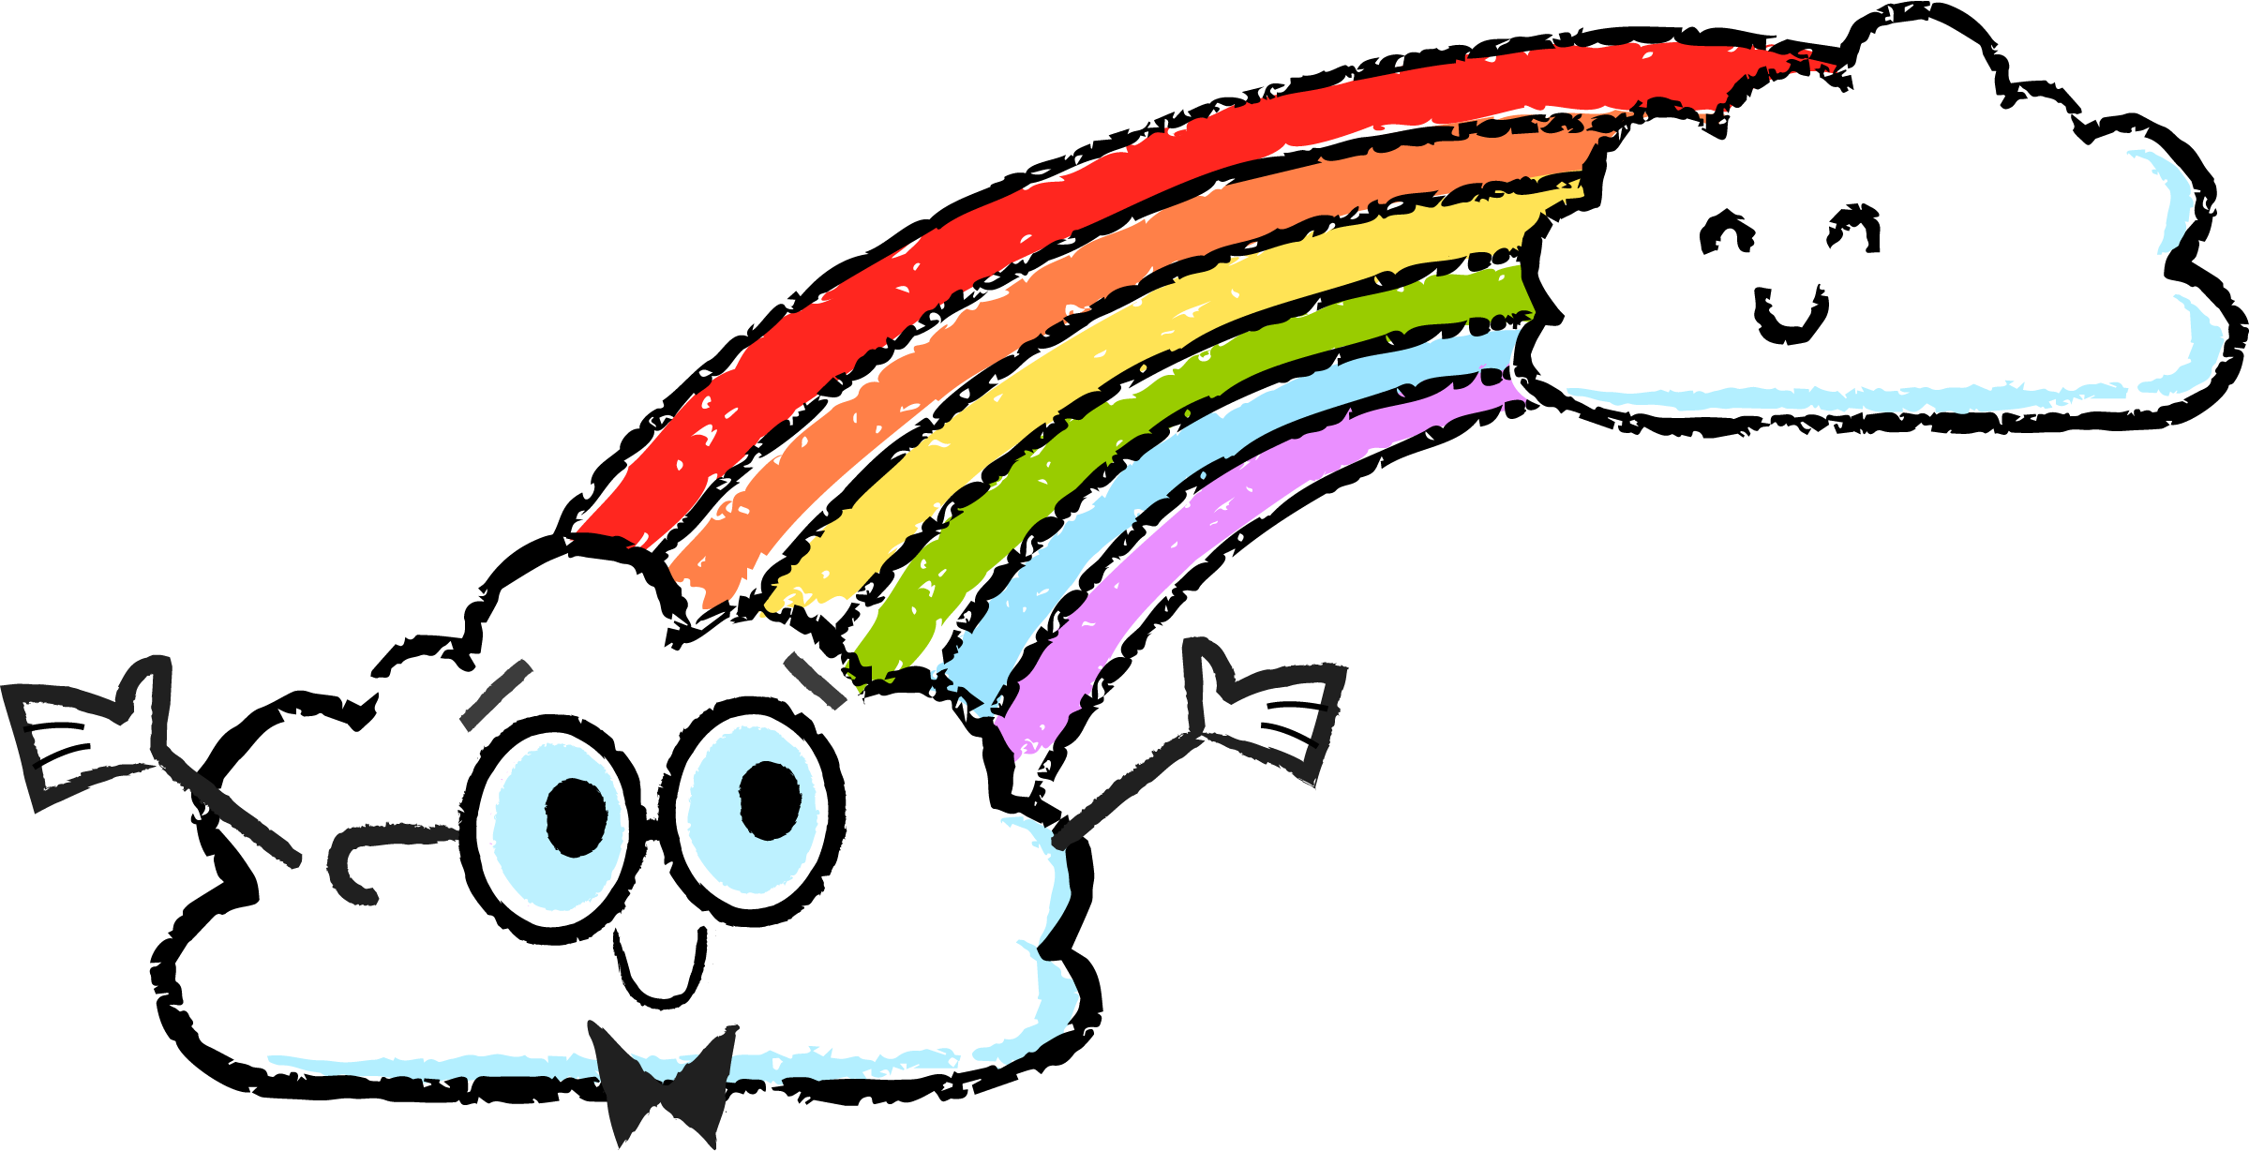
Now, you try it!
Name It!
Forecast It!
Notes:
DIRECTIONS:
Help children work through the activities to practice identifying, labeling, and predicting *feelings. The activities can be presented in any order; however, they do build in complexity.
Name It! In this activity, children identify and label feelings.
Forecast It! In this activity, children predict how they might feel based on a given situation and how that feeling might impact their actions.
SAY:
Let’s practice identifying, predicting, and labeling feelings with Cloudy!
*feeling an emotional state or reaction like being happy, sad, angry, etc.

Slide 11
Name It!
loved.
silly.
grumpy.
thrilled.
Notes:
DIRECTIONS:
Read the feeling words on the slide. Ask children which emoji best matches the feeling word. Drag and drop the feeling word to the emoji.
SAY:
Let’s practice labeling *feelings by looking at these emojis and deciding which feeling word best matches each one. [Ask children what the feeling word means to them. Then discuss why they think that feeling word matches the emoji. Drag and drop the feeling word to the emoji that represents it. Correct answers from top to bottom: grumpy, silly, loved, and thrilled]
Can you think of a time you felt one of these feelings? Why did you feel that way? What did you do? [Discuss responses.]
You did it! You labeled all the emojis with their correct feelings. Did you learn any new feeling words in this activity? [Pause to discuss responses.]
*feeling an emotional state or reaction like being happy, sad, angry, etc.

Slide 12
Name It!
glad.
disappointed.
surprised.
shy.
Notes:
DIRECTIONS:
Read the feeling words on the slide. Ask children which emoji best matches the feeling word. Drag and drop the feeling word to the emoji.
SAY:
Let’s practice labeling *feelings by looking at these emojis and deciding which feeling word best matches each one. [Ask children what the feeling word means to them. Then discuss why they think that feeling word matches the emoji. Drag and drop the feeling word to the emoji that represents it. Correct answers from top to bottom: disappointed, glad, shy, and surprised]
Can you think of a time you felt one of these feelings? Why did you feel that way? What did you do? [Discuss responses.]
You did it! You labeled all the emojis with their correct feelings. Did you learn any new feeling words in this activity? [Pause to discuss responses.]
*feeling an emotional state or reaction like being happy, sad, angry, etc.

Slide 13
Name It!
[type here].
[type here].
[type here].
[type here].
[type here].
Notes:
DIRECTIONS:
Look at the emojis on the screen. Ask children to label the emoji with a feeling word. Type the feeling word into the space provided.
SAY:
Let’s practice labeling *feelings by looking at these emojis and thinking of a feeling word to describe each one. [Brainstorm feeling words that could match each emoji. Type the feeling word into the space provided. Answers will vary. Possible feeling words from top to bottom: sad/upset/worried/anxious, bored/content/shocked, angry/furious/mad, curious/thoughtful, and creative]
Can you think of a time you felt one of these feelings? Why did you feel that way? What did you do? [Discuss responses.]
You did it! You labeled each emoji with a feeling word. I noticed that there could be more than one feeling word associated with each emoji. What does that tell us about feelings? [People express their feelings in different ways. Our faces can display multiple ways to show one feeling.]
Did you learn any new feeling words in this activity? [Pause to discuss responses.]
*feeling an emotional state or reaction like being happy, sad, angry, etc.

Slide 14
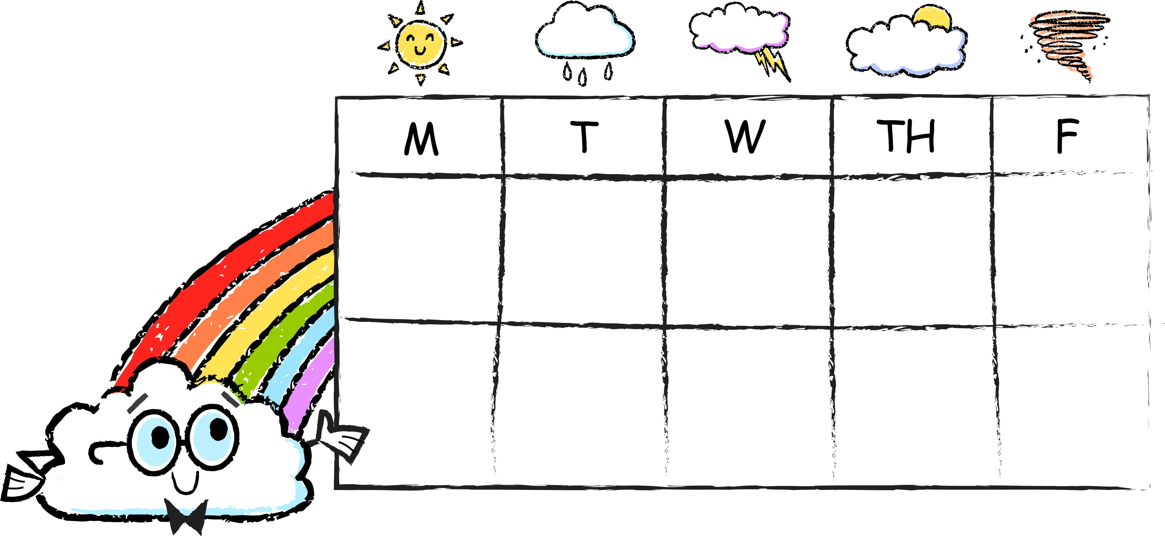
Forecast It!
Today’s feeling
forecast is...
You helped score a goal.
You tripped and scraped your knee.
Your ice cream cone fell on the ground.
You sign up for swim lessons.
Your best friend comes over to play!
I feel…
I feel…
I feel…
I feel…
I feel…
Notes:
DIRECTIONS:
Read the situation for each day of the week. Ask children to predict how they might feel. Type responses into the space provided.
SAY:
Cloudy wants to give a *feelings forecast. To do that we need to predict how we might feel in a certain situation.
Why do think it is important to think about how you might feel? [Discuss responses.] If you know how you might feel, it will help you understand how you might act in that situation. How we feel affects how we behave. It will also help you the next time a certain situation or similar situation happens again.
Let’s predict how we might feel. [Read each situation and pause to discuss how children might feel if that happened to them. Remind children that there are no wrong answers. Validate all the emotions that children share. Choose one response to type into the chart on the slide. To help children express their feelings use the sentence frame: I feel ___(emotion) because_______.]
Monday: You helped score a goal. If this happened to you, how might you feel? [Possible response: I feel proud because I helped my team.]
Tuesday: You tripped and scraped your knee. If this happened to you, how might you feel? [Possible response: I feel hurt because a scraped knee is painful.]
Wednesday: Your ice cream cone fell on the ground. If this happened to you, how might you feel? [Possible response: I feel disappointed because I was really looking forward to eating my ice cream.]
Thursday: You sign up for swim lessons. If this happened to you, how might you feel? [Possible response: I feel excited because I want to learn how to swim.]
Friday: Your best friend comes over to play. If this happened to you, how might you feel? [Possible response: I feel surprised because I didn’t know my friend was coming over and it made my day more special.]
Wow, what a range of feelings! So much happened this week that made us feel a certain way. I noticed that we had different reactions or feelings for each one of these situations. This tells me that everyone reacts to things differently and feels a certain way, and that is okay! If we know how we might feel, it will help us learn how to manage our emotions. Remember, how we feel affects how we act. How would you act if your ice cream cone suddenly fell on the ground? [Discuss responses.]
*feeling an emotional state or reaction like being happy, sad, angry, etc.

Slide 15
Let’s Reflect!

Slide 16
Journal It! Chat About It!
REFLECT ON THE GUIDING QUESTION
What is a feeling?
Notes:
DIRECTIONS:
After labeling and predicting *feelings, revisit this lesson’s Guiding Question.
Have children reflect on what they learned by writing or drawing ideas in their journal. Offer children a chance to share ideas with the group or a partner if they are comfortable.
SAY:
Today we talked about feelings. Feelings are reactions to what is going on around us. Our feelings impact how we act. For example, if you’re upset, you might want to be alone. If you feel surprised, you might jump up and down. It’s important to predict or think about how we might feel, so that we can think about how our feelings impact our behavior.
[Journal It!] In your journal, continue writing or drawing about what makes you feel a certain way. If you learned some new feeling words in this lesson, add them to your journal. Think about how you act when you experience these feelings. What do you do and why? [Allow children time to write or draw in their journal.]
[Chat About It!] Does anyone feel comfortable sharing what makes them feel a certain way? [Have children share if they feel comfortable. They can share as a group or with a partner.]
*feeling an emotional state or reaction like being happy, sad, angry, etc.

Slide 17
You did it!
Notes:
DIRECTIONS:
Celebrate children’s accomplishment in learning how to be more aware of their *feelings.
SAY:
Cloudy is proud of you! You finished the lesson on being more aware of how you feel, and you learned some new feeling words.
Pat yourself on the back and say, “Way to go!”
Your feelings have an impact on how you act. Identify and name your feelings to become more aware of how you feel. Think about how you would feel in certain situations to help you understand your behavior. Remember, it’s okay to feel a certain way! How you feel is real and all your feelings matter.
*feeling an emotional state or reaction like being happy, sad, angry, etc.

